Slide 1

Minor Project – IA-1 Bachelor of Science (Honours) in Cloud Computing & Big Data V Semester – 2024
School of Computer Science and Applications

Slide 2
PROJECT REPORT ON Synthesis AI: Unified API Integration
IA-1 Project Report
Completion of V BSc. (Honours) in Cloud Computing & Big Data
Presented by:
Mr. Bhamidi Venkata Gowri Sai Sashank
SRN: R22DB007
Internal Guide:
Prof. Anitha Rani K S

Slide 3
Agenda
Introduction
Abstract
Software hardware Requirement
Existing system and Proposed system
Architecture Diagram
Module Description
Methodology used
Conclusion

Slide 4
INTRODUCTION
Context: The proliferation of Large Language Models (LLMs) has created a fragmented ecosystem where users must navigate multiple platforms, interfaces, and authentication systems to leverage different AI capabilities. Each provider offers unique strengths, but accessing these services requires juggling between separate websites and APIs.
Problem Statement: Cloud providers need a structured framework to ensure that AI systems are governed efficiently, maintaining fairness, transparency, and data security. Without this, AI systems can lead to unintentional harm, such as decision-making and data breaches.
Objective: Synthesis AI aims to address these challenges by developing a client-side web platform that unifies access to multiple LLM providers through a single, cohesive, cyberpunk-inspired interface while keeping API keys strictly client-side.

Slide 5
Abstract
Overview: The Synthesis AI platform will provide users with a unified interface to access OpenAI, Anthropic, and Perplexity APIs. It will be built using modern web technologies with client-side encryption for API keys, conversation management features, and real-time token usage tracking. The project will focus on enhancing privacy, improving productivity across multiple AI services, and offering a consistent user experience.
Project Website: The platform will be hosted at https://synai.site, featuring a minimalist, cyberpunk-inspired interface with a monochrome aesthetic.

Slide 6
Software/hardware requirements
Background: LLM services are increasingly essential tools for professionals and researchers, but the current fragmented landscape creates inefficiencies and security concerns when managing multiple services.
Solution: The proposed platform, Synthesis AI, will unify multiple AI providers in a single interface while keeping all API keys encrypted and stored client-side. The framework will be developed using modern web technologies and follow responsive design principles for cross-device compatibility.
Project Overview: The development of Synthesis AI will involve creating a secure authentication system, building a unified conversation interface, implementing analytics features, and ensuring a cohesive design language across all components.

Slide 7
Existing System vs. proposed system
Existing System
Challenges: Current solutions are either provider-specific platforms limited to their own models, developer-focused API tools with poor UX, middleware solutions requiring server-side processing of API keys, or open-source alternatives with complex setup requirements.
Impact: Users face cognitive overhead, security risks, and reduced productivity when working with multiple AI providers.
Proposed System
Synthesis AI: A client-side focused platform that integrates multiple AI providers while maintaining strict privacy standards. Synthesis AI features client-side API key encryption, a unified conversation interface, comprehensive management tools, and real-time analytics.
Benefits: Enhanced privacy with client-side key storage, improved productivity across multiple models, cost transparency, and a consistent cyberpunk-inspired user experience.

Slide 8
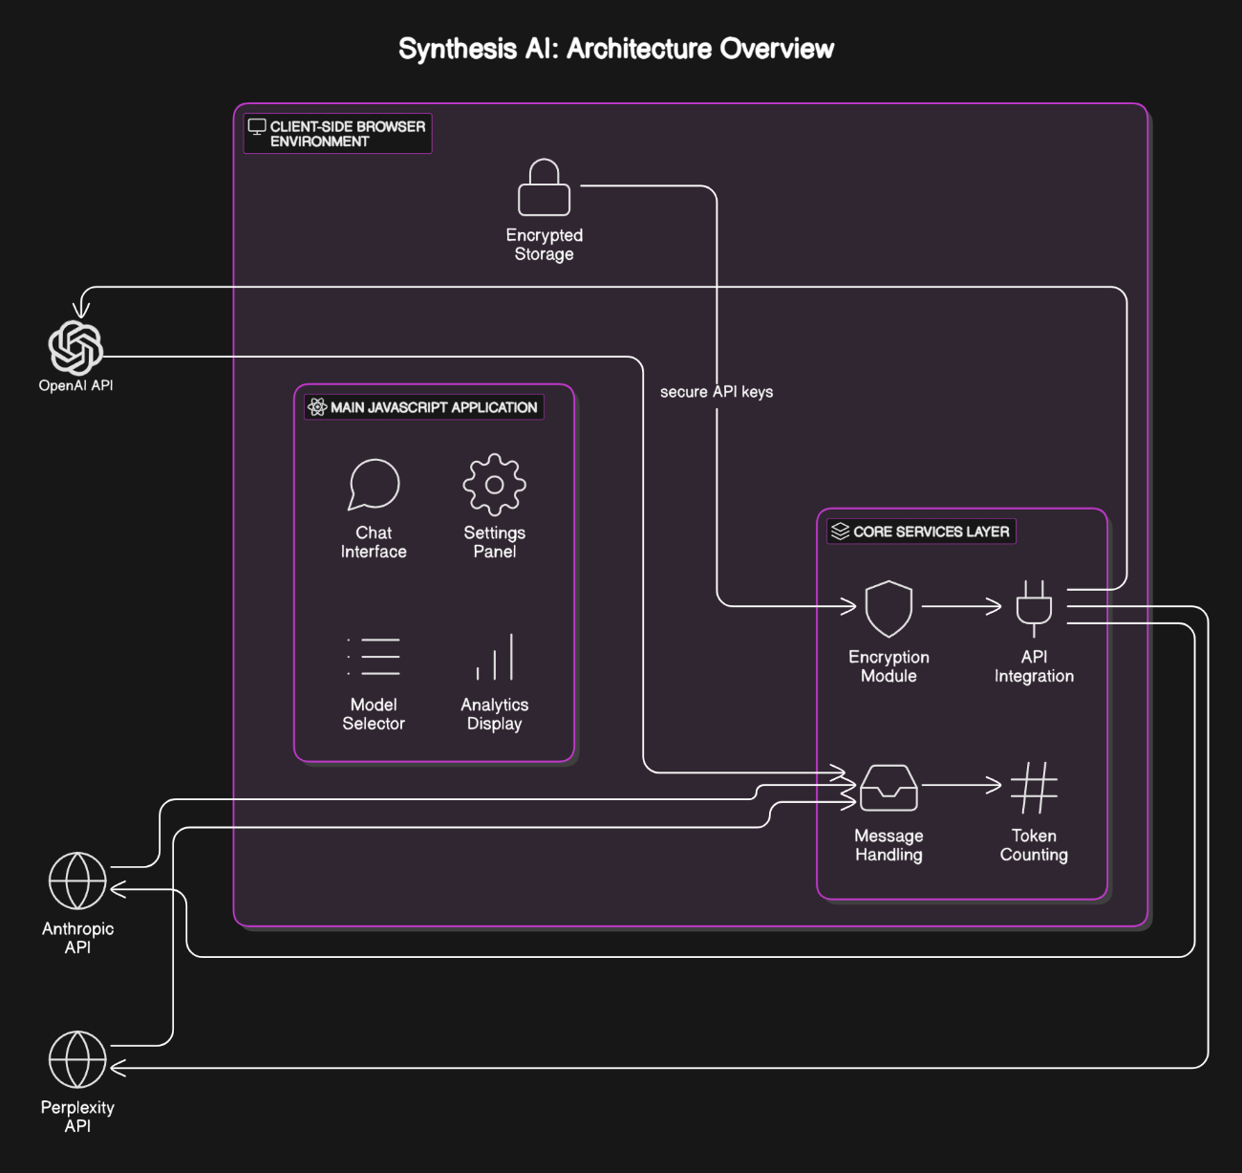
Architecture Diagram

Slide 9
Module Description
Module 1: Authentication and API Key Management Module:
Client-side encryption of API keys, Validation system for API key testing, Visual indicators for configured services, Secure storage implementation using browser technologies.
Module 2: Conversation Interface Module:
Real-time message streaming, Markdown and code syntax highlighting, Thread management and organization, Provider-specific features and capabilities.
Module 3: Settings and Configuration Module:
System prompt templates and customization, Model selection and parameter adjustment, Interface customization options, Keyboard shortcut configuration.

Slide 10
Module Description
Module 4: Analytics and Reporting Module:
Token usage tracking and visualization, Cost estimation based on current provider pricing, Usage patterns and statistics, Export and reporting capabilities.
Module 5: Export and Integration Module:
Multiple export format support (Markdown, PDF, JSON), Sharing capabilities with privacy controls, Integration with file systems for saving/loading conversations, Batch operations for conversation management

Slide 11
Methodology Used
Development Process:
Follows the Agile methodology with iterative development. Each feature will be developed in sprints focusing on specific modules like authentication, conversation interface, and analytics.
Testing:
Each sprint will include comprehensive testing across multiple browsers and devices to ensure responsive design principles are maintained and client-side security measures function correctly.

Slide 12
Conclusion
Synthesis AI is a unified platform designed to address the fragmentation in the AI services landscape. By integrating multiple LLM providers through a secure, client-side focused implementation, Synthesis AI provides users with a cohesive, cyberpunk-inspired interface that enhances productivity while maintaining strict privacy standards.

Slide 13
Experience the Future of AI Integration Today

